Slide 1

Customer Segmentation Through Purchase History Data
Submitted by:
Tejas Shinde(230943025050)
Shruti Kharsade(230943025046)
Pranita Wani(230943025038)
Jay Chaudhari(230943025025)
Guided By:
Miss Trupti Joshi
Prasad Deshmukh

Slide 2
What is Customer Segmentation?
Divides customers into groups with similar characteristics or behaviors.
Used to tailor marketing strategies effectively based on specific customer needs and behaviors.
It helps businesses improve customer satisfaction, increase sales, and optimize marketing ROI.

Slide 3
Problem Statement
Businesses struggle to extract insights from vast customer purchase data.
Inefficient analysis and lack of integration hinder effective segmentation and targeted strategies, impacting growth and competitiveness.
We aim to utilize the potential of purchase history data to segment customers effectively, facilitating personalized marketing campaigns and maximizing customer satisfaction.

Slide 4
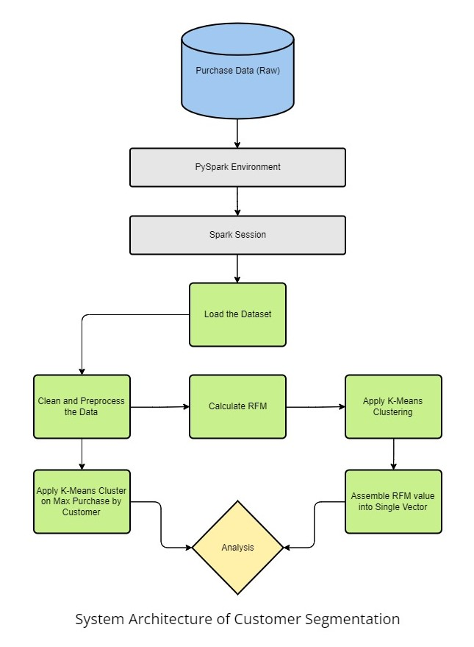

Slide 5
Dataset Information
2.6M rows, 8 columns: event_time, order_id, product_id, category_id, category_code, brand, price, user_id.
Contains purchase data, enabling analysis of customer behavior and preferences for segmentation and targeted strategies.

Slide 6
Data Cleaning Process
Removed duplicate records .
Kept the data for year 2020 only as there were only 2 distinct years(1970,2020).
Removed the records ,where brand values are none.
Assign category as miscellaneous where null values are present.
Split the category_code column into 3 columns (cat_1,cat_2,cat_3) on the occurrence of dot ‘.’

Slide 7
Data Cleaning Process
Calculated average of price column and assign that value to records where price were zero.
Among 2 million records , 1.5 million user ids are not available.
The challenge here was to fill null values of user id from available distinct user id such that it should not affect the consistency of data.
Calculated the count of distinct user IDs for each category and assigned random user IDs to null values on basis of category column.

Slide 8
RFM Model
RFM stands for Recency, Frequency, Monetary.
It is a marketing analysis technique used to evaluate customer behavior.
It is ideal for numerical data.
As purchase dataset includes transactional information like order_id, event_time, price. RFM model will be perfectly fit for this scenario.

Slide 9
Algorithms
The algorithms that can be used with numerical data are PCA, Hierarchical clustering, DBSCAN, K-means clustering.
PCA doesn’t directly support RFM method.
DBSCAN has difficulty with high dimensional data.
Hierarchical clustering's nested hierarchy may not align well with intuitive RFM-based customer segments.

Slide 10
K-MEANS Clustering
Well-suited for segmenting customers based on RFM metrics.
Efficiently partitions the data into clusters by minimizing the sum of squared distances between data points.
Assemble RFM score into single feature vector.
Apply trained K-means model to make the predictions, assigning each customer to the nearest cluster centroid.
Interpret resulting clusters to understand customer segments based on purchasing behavior.

Slide 11
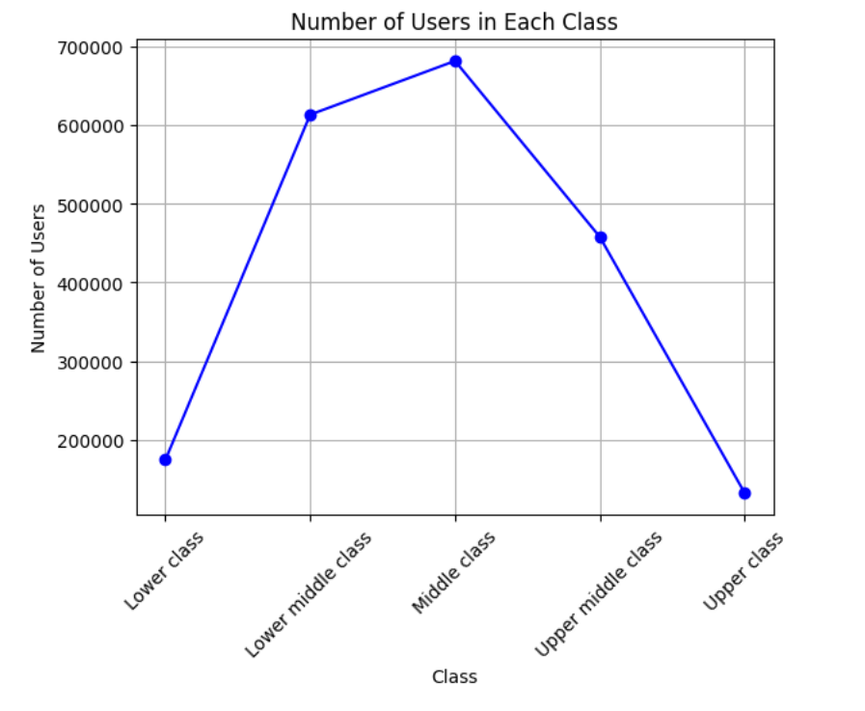
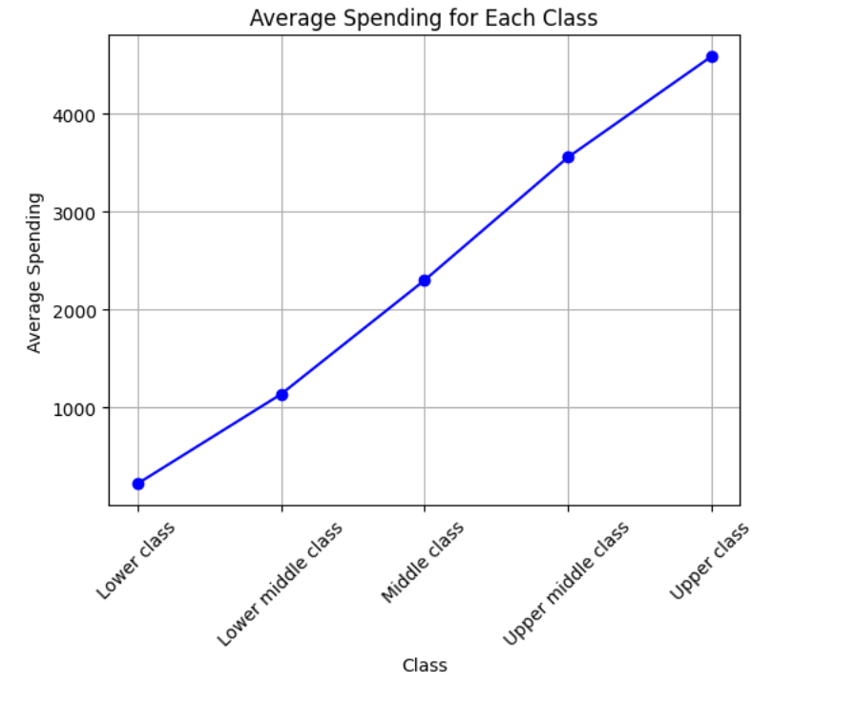
Visualizations

Slide 12
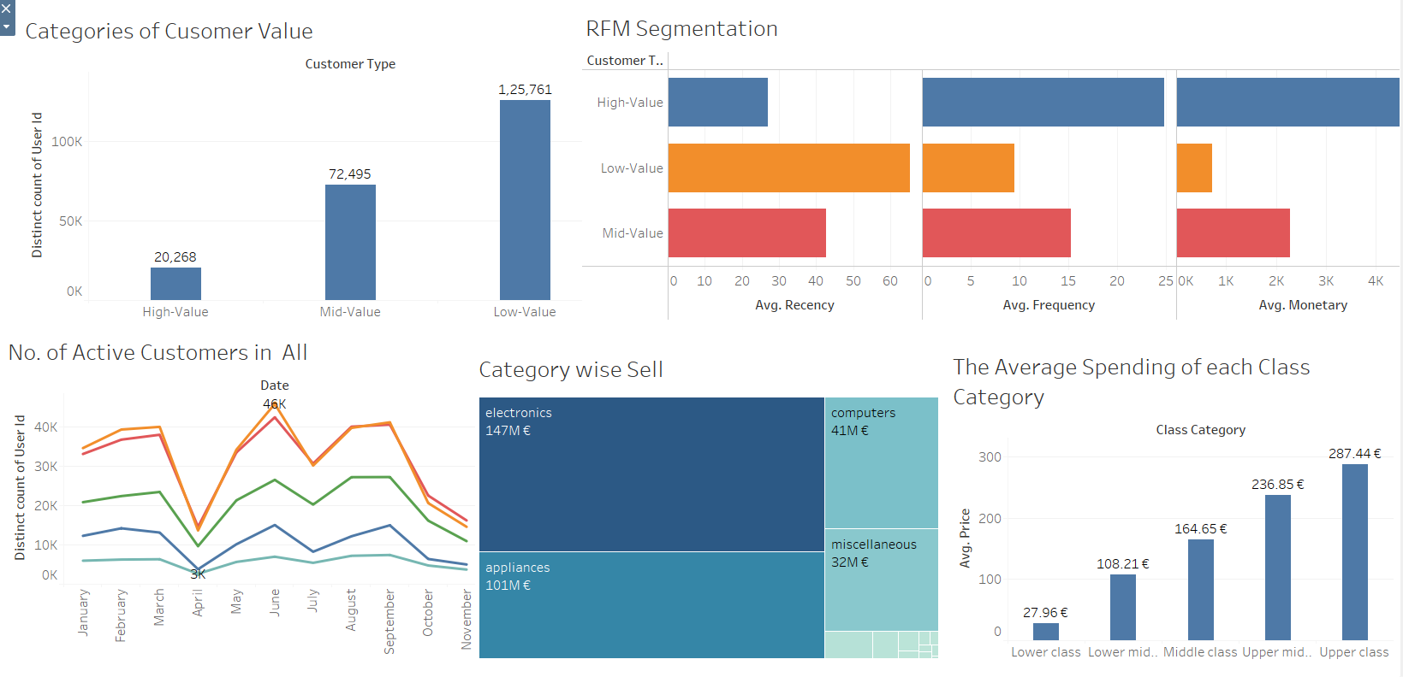
https://public.tableau.com/app/profile/tejas.shinde6818/viz/CDAC-Project_17086852664780/CustomerSegmentationDashboard?publish=yes

Slide 13
Analysis
The lower class people are more frequent and buy those products which are cheaper so we can get through analysis that these products availaibilty should be more.
And upper class people purchases products after a long time but when they come to purchase they buy large amount of products which are costlier.

Slide 14
Conclusion
Our project on customer segmentation through purchase history data offers valuable insights for e-commerce stakeholders.
Utilizing RFM analysis and K-means clustering, we segment customers effectively based on their purchasing patterns, enabling targeted marketing strategies.
This approach reveals variations in profitability among customer segments and provides a structured framework for optimizing business strategies and driving growth.

Slide 15
THANK YOU

